Slide 1
W E L C O M E
Thanks for coming!

Slide 2

Developer and Platform Evangelism Team

Slide 3
Schedule
Time | Activity
8:00am-8:30am | Welcome (and coffee)
8:30am-9:15am | Intro To Agile
9:15am-10:15am | Refactoring to a S.O.L.I.D. Foundation
10:15am-10:30am | <break>
10:30am-11:45pm | Agile Estimation (+ lab)
11:45am-12:15pm | <lunch> (and tools install)
12:15pm-1:45pm | Test-Driven Development (+ lab)
1:45pm-2:00pm | <break>
2:00pm-3:00pm | Continuous Integration
3:00pm-3:15pm | <break> (and snack)
3:15pm-4:30pm | Dependency Injection/IoC (+ lab)
4:30pm-5:30pm | Retrospective and wrap-up

Slide 4

Important Places

Slide 5
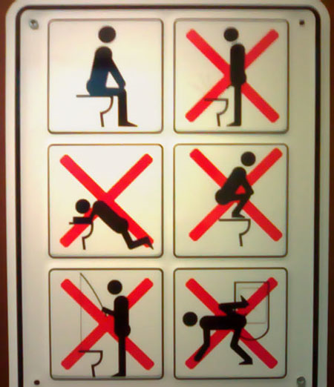
Simple Rules

Slide 6

Look Down!

Slide 7

HELP ME!

Slide 8
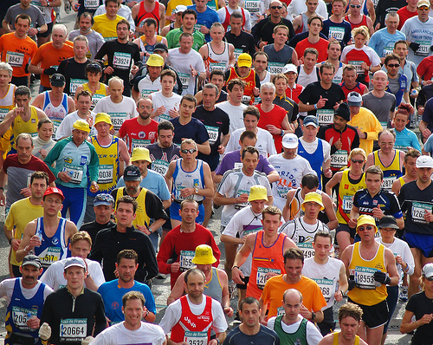
Crowds and Logistics

Slide 9

#agilefire

Slide 10

Ain’t Gonna Happen!

Slide 11
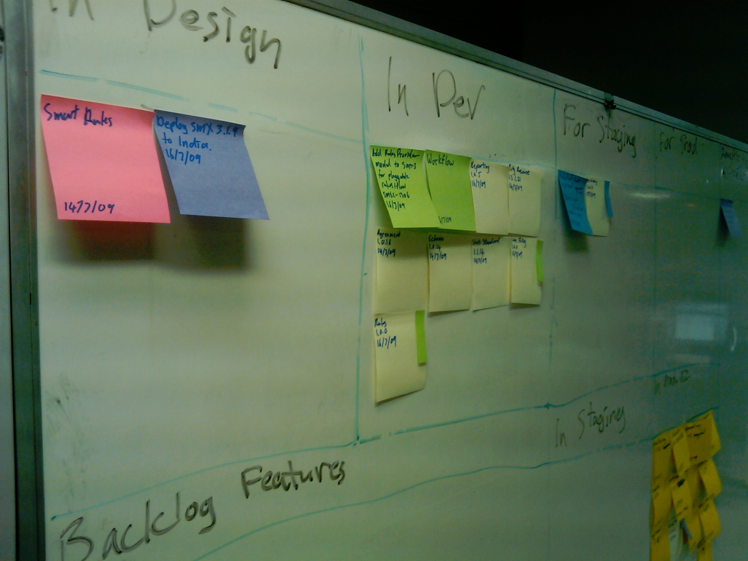
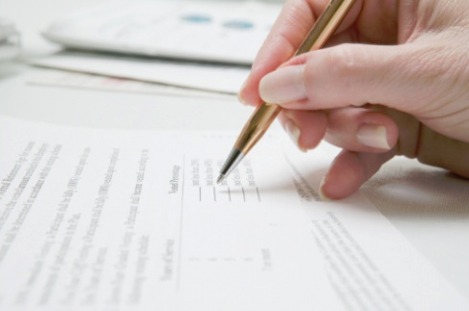
Feedback Process

